Slide 1
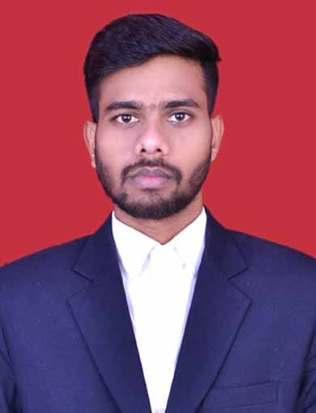

Ashutosh kumar
Professional Experience
Good hands-on experience in Mainframe.
Expertise in client application development JCL and Cobol.
Developed database objects like Tables, Views, Partitions, Functions, Procedures, Packages.
Loaded data into tables from flat files using SQL Loader.
Good knowledge on Data flow diagrams, ER modelling.
Root cause analysis of issues and providing immediate fix to reduce the impact.
I am working some advance type of project in 6 months training
Like Banking system.
Committed for on-time delivery and support during critical times.
Excellent communication and analytical skills.
I am also working in VSAM , GDG and Sort .
Analyst/Software Engineer
Profile
IT Professional with 6 month of programming experience in Mainframe. Analyse, design and development of business applications using DB2 database. Developed advance program packages, procedures, functions and collections in mainframe to implement business logics of critical applications.
Key Skills:
Operating Systems -> Windows 10, Unix.
Languages -> JCL , ispf , cobol and cics , Java , Python
Packages -> MS-Office, Office-365, Share Point.

